Slide 1
Firewalls
firewall
isolates organization’s internal net from larger Internet, allowing some packets to pass, blocking others.
administered
network
public
Internet
firewall

Slide 2
Firewalls: Why
prevent denial of service attacks:
  SYN flooding: attacker establishes many bogus TCP connections, no resources left for “real” connections
prevent illegal modification/access of internal data.
  e.g., attacker replaces CIA’s homepage with something else
allow only authorized access to inside network (set of authenticated users/hosts)
main types of firewalls:
  stateless packet filters
  stateful packet filters
  application gateways
  next generation firewall

Slide 3
Stateless packet filtering
Should arriving packet be allowed in? Departing packet let out?
internal network connected to Internet via router firewall
router filters packet-by-packet, decision to forward/drop packet based on:
  source IP address, destination IP address
  TCP/UDP source and destination port numbers
  ICMP message type
  TCP SYN and ACK bits

Slide 4
Stateless packet filtering: example
example 1: block incoming and outgoing datagrams with IP protocol field = 17 and with either source or dest port = 23.
  all incoming, outgoing UDP flows and telnet connections are blocked.
example 2: Block inbound TCP segments with ACK=0.
  prevents external clients from making TCP connections with internal clients, but allows internal clients to connect to outside.

Slide 5
Stateless packet filtering: more examples
Policy | Firewall Setting
No outside Web access. | Drop all outgoing packets to any IP address, port 80
No incoming TCP connections, except those for institution’s public Web server only. | Drop all incoming TCP SYN packets to any IP except 130.207.244.203, port 80
Prevent Web-radios from eating up the available bandwidth. | Drop all incoming UDP packets - except DNS and router broadcasts.
Prevent your network from being used for a smurf DoS attack. | Drop all ICMP packets going to a “broadcast” address (eg 130.207.255.255).
Prevent your network from being tracerouted | Drop all outgoing ICMP TTL expired traffic

Slide 6
Access Control Lists
ACL: table of rules, applied top to bottom to incoming packets: (action, condition) pairs
action | source address | dest address | protocol | source port | dest port | flag bit
allow | 222.22/16 | outside of 222.22/16 | TCP | > 1023 | 80 | any
allow | outside of 222.22/16 | 222.22/16 | TCP | 80 | > 1023 | ACK
allow | 222.22/16 | outside of 222.22/16 | UDP | > 1023 | 53 | ---
allow | outside of 222.22/16 | 222.22/16 | UDP | 53 | > 1023 | ----
deny | all | all | all | all | all | all

Slide 7
Stateful packet filtering
stateless packet filter: heavy handed tool
  admits packets that “make no sense,” e.g., dest port = 80, ACK bit set, even though no TCP connection established:
action | source address | dest address | protocol | source port | dest port | flag bit
allow | outside of 222.22/16 | 222.22/16 | TCP | 80 | > 1023 | ACK
stateful packet filter: track status of every TCP connection
  track connection setup (SYN), teardown (FIN): can determine whether incoming, outgoing packets “makes sense”
  timeout inactive connections at firewall: no longer admit packets

Slide 8
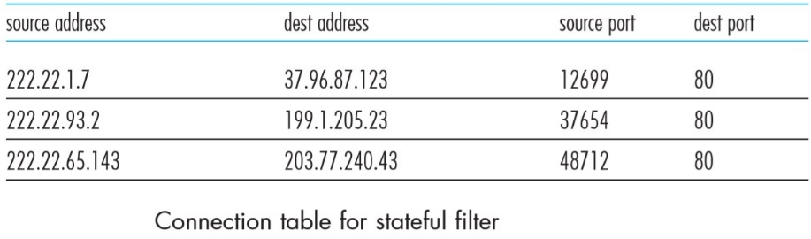
Connection Table

Slide 9
Stateful packet filtering
ACL augmented to indicate need to check connection state table before admitting packet
action | source address | dest address | proto | source port | dest port | flag bit | check conxion
allow | 222.22/16 | outside of 222.22/16 | TCP | > 1023 | 80 | any
allow | outside of 222.22/16 | 222.22/16 | TCP | 80 | > 1023 | ACK | x
allow | 222.22/16 | outside of 222.22/16 | UDP | > 1023 | 53 | ---
allow | outside of 222.22/16 | 222.22/16 | UDP | 53 | > 1023 | ---- | x
deny | all | all | all | all | all | all

Slide 10

Application gateways
gateway-to-remote
host telnet session
host-to-gateway
telnet session
filters packets on application data as well as on IP/TCP/UDP fields.
example: allow select internal users to telnet outside.
application
gateway
router and filter
1. require all telnet users to telnet through gateway.
2. for authorized users, gateway sets up telnet connection to dest host. Gateway relays data between 2 connections
3. router filter blocks all telnet connections not originating from gateway.

Slide 11
Limitations of firewalls and gateways
IP spoofing: router can’t know if data “really” comes from claimed source
if multiple app’s. need special treatment, each has own app. gateway.
client software must know how to contact gateway.
  e.g., must set IP address of proxy in Web browser
filters often use all or nothing policy for UDP.
tradeoff: degree of communication with outside world, level of security
many highly protected sites still suffer from attacks.

